Slide 1


Turbulent Gas Motion in Interacting Galaxy Systems
Connor Auge
Dr. Lisa Chien
Northern Arizona University

Slide 2
Acknowledgements
Dr. Lisa Chien
The NAU/NASA Space Grant
The Hooper Undergraduate Research Award
NASA Hubble Space Telescope (HST) and
NRAO Very Large Array (VLA)

Slide 3


Interacting Galaxies
Arp 256 - First encounter
Arp 299 - Second encounter
IC 883 - Merged
Visible & Hα images from HST
A system of galaxies in the process of colliding
Increased star formation rate
Disturbed gas motions with shocks and turbulence

Slide 4
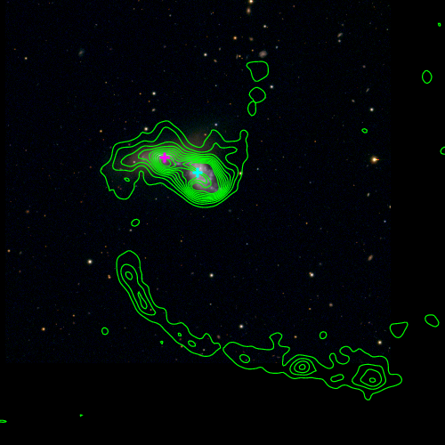
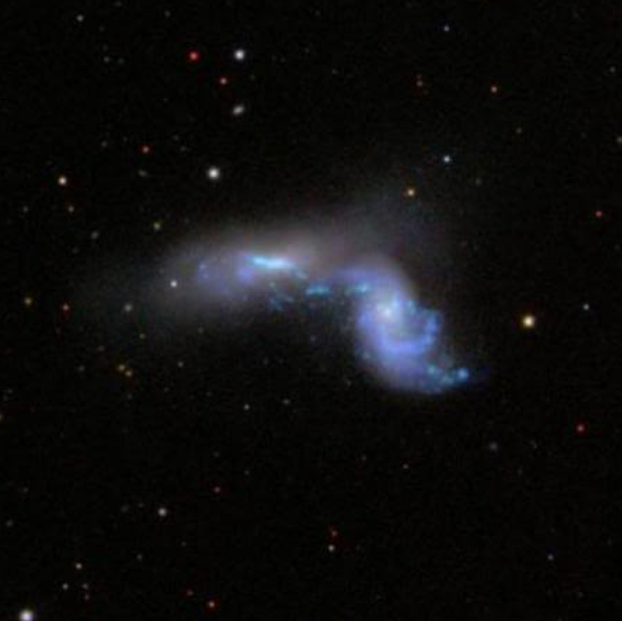
Turbulence
Turbulent gas motion is present in all galaxies over a wide range of distance scales
Turbulence and Sonic Mach Number (indicative of shocks) may have a correlation to stage of interaction and star formation
NGC 3395/96- Second encounter
Contours of Neutral Hydrogen Gas from VLA
Visible image from the Discovery Channel Telescope

Slide 5
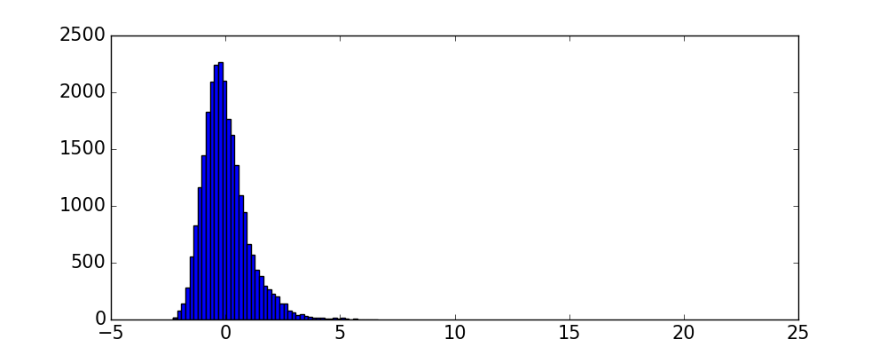
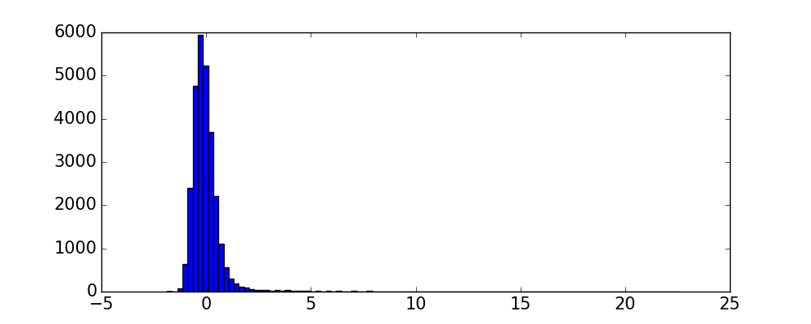
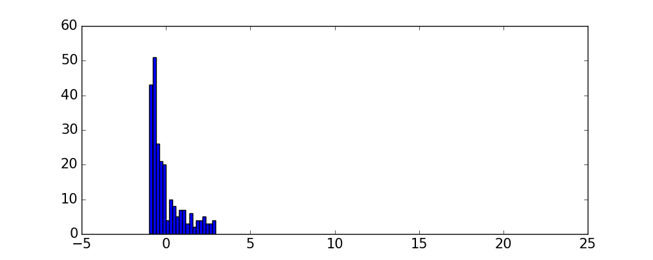
Whole Image Statistics
Arp 256
Skewness: 1.19
Kurtosis: 2.81
Gaussian asymmetries are shown by the higher order statistical moments, the skewness and the kurtosis.
An increase in these asymmetries corresponds to an increase in the turbulence and the Sonic Mach Number.
Arp 299
Skewness: 8.56
Kurtosis: 121.69
Number of Pixels
IC 883
Skewness: 1.30
Kurtosis: 0.656
Normalized Surface Density

Slide 6
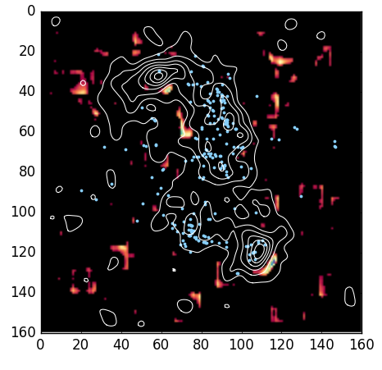
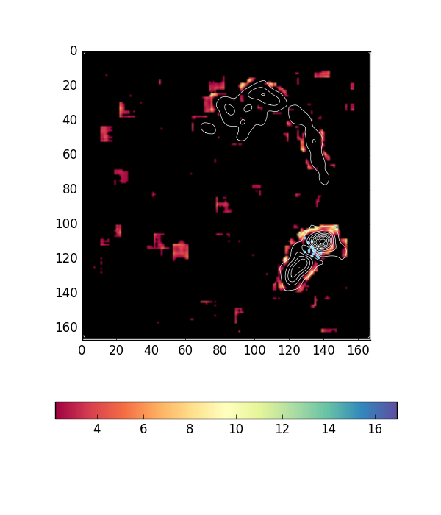
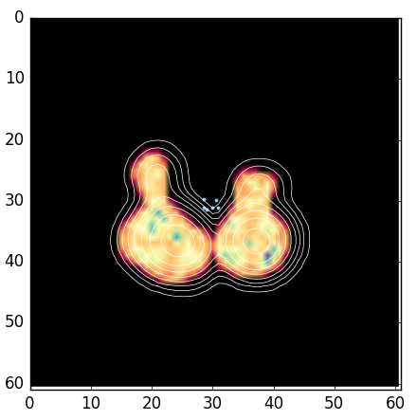
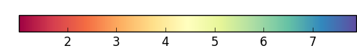

Kurtosis Maps
Arp 256 - First encounter
Arp 299 - Second encounter
IC 883 - Merged
-10.35
34.44
33.33
DEC
DEC
DEC
-10.39
4.73
RA
4.69
33.11
34.36
161.86
RA
161.59
199.62
RA
199.52

Slide 7
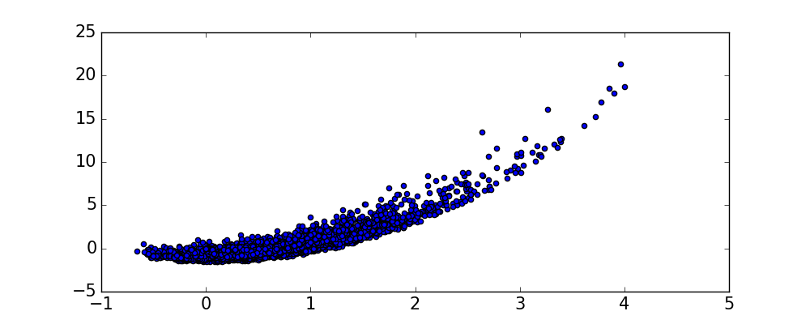
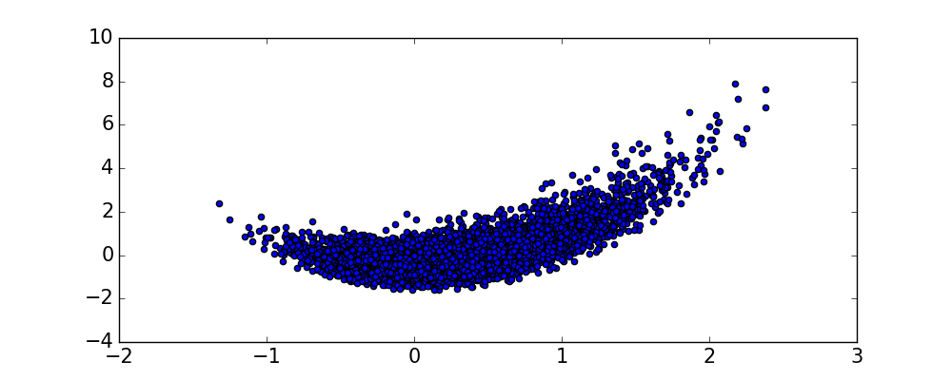
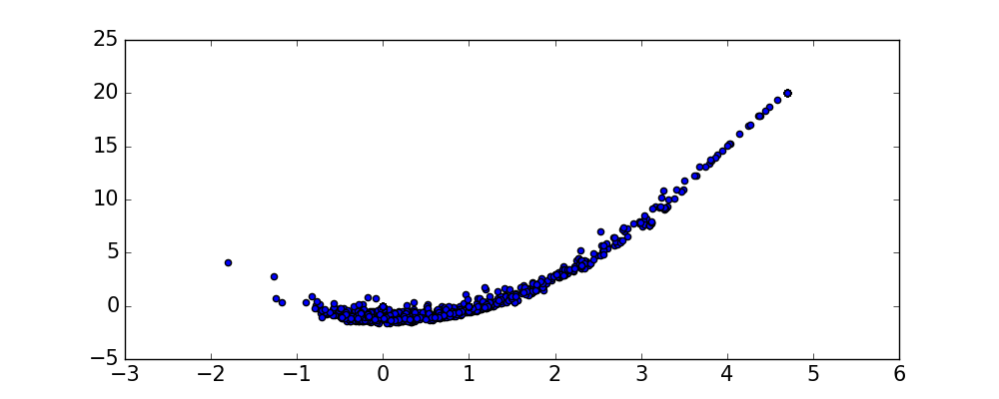
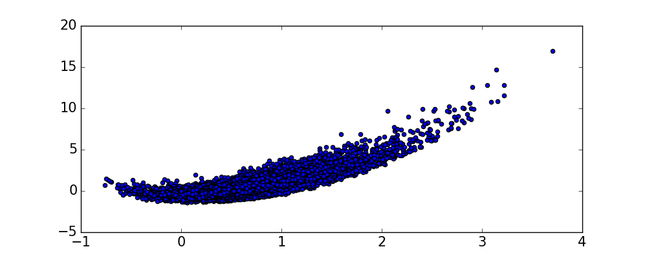
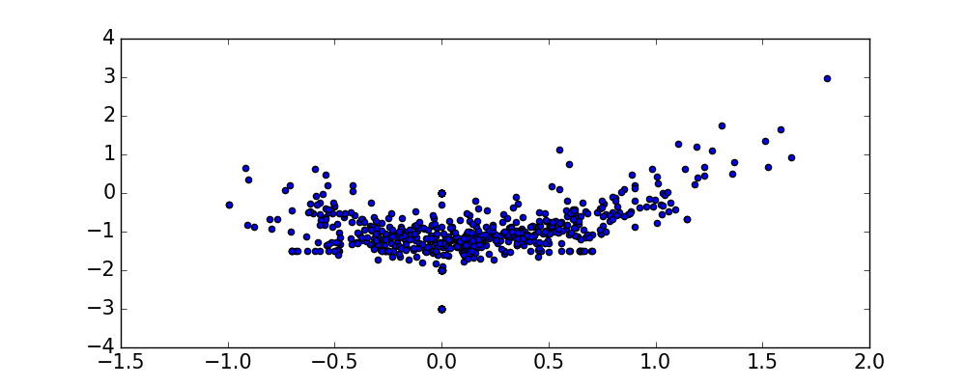
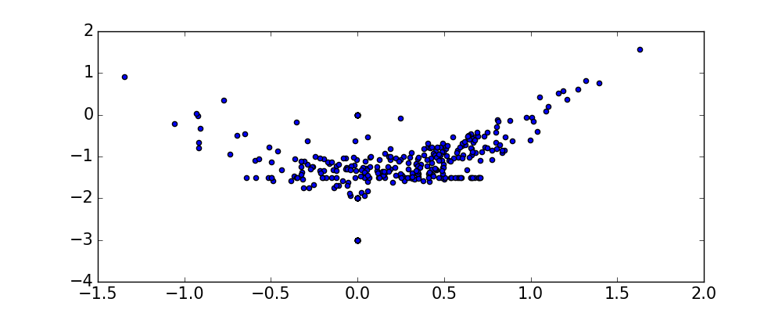
Sonic Mach Number Relation
NGC 2388 – First encounter
Arp 256 – First encounter
NGC 4676 – Second encounter
Arp 299 – Second encounter
Kurtosis
Kurtosis
Supersonic
turbulence
Supersonic
turbulence
NGC 2623 – Merged
IC883 – Merged
Subsonic
turbulence
Subsonic
turbulence
Skewness
Skewness

Slide 8
Conclusions
Each interacting galaxy system has unique gas motion.
Systems in the middle of the interaction near the second closest encounter seem to have the highest turbulence.
There is a correlation to the stage of interaction and the Sonic Mach Number of the gas in the system.

